Slide 1



The Planet Forming Region Around a Young Star
Ian J. Winner¹, Gijs Mulders²
University of Arizona
Steward Observatory¹, Lunar and Planetary Laboratory²

Slide 2
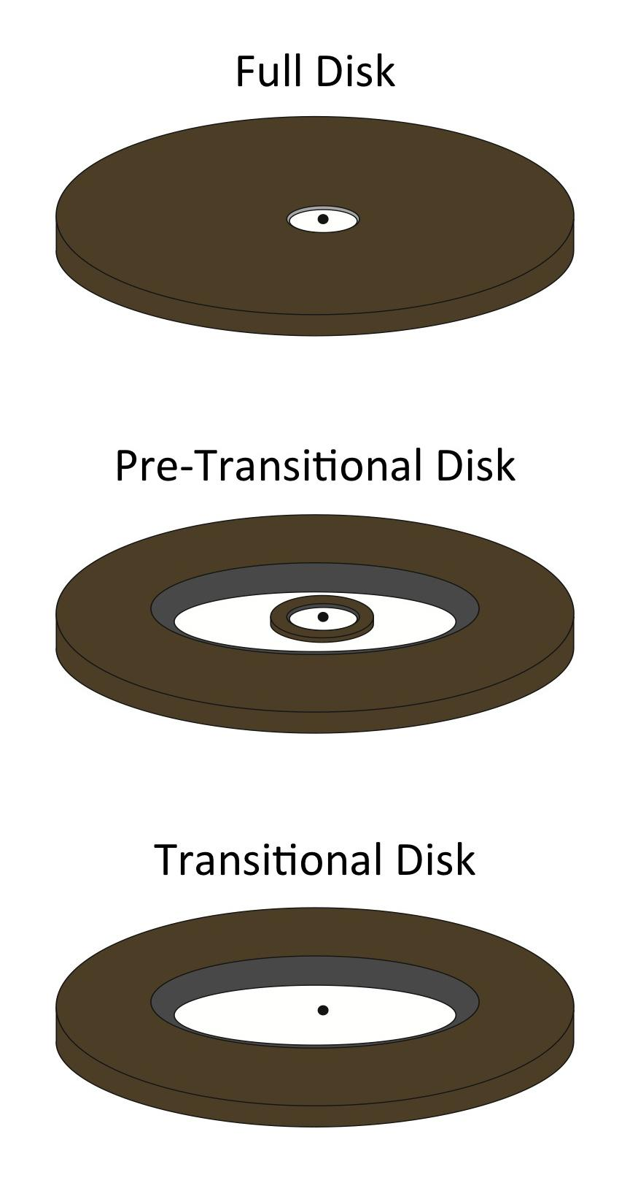
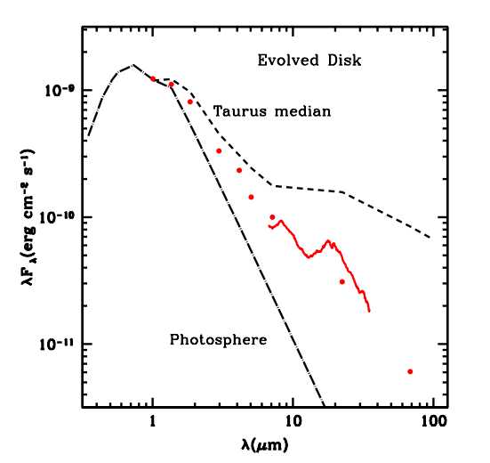
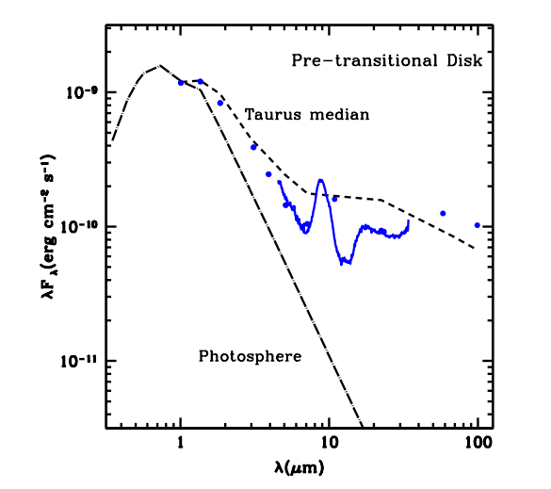
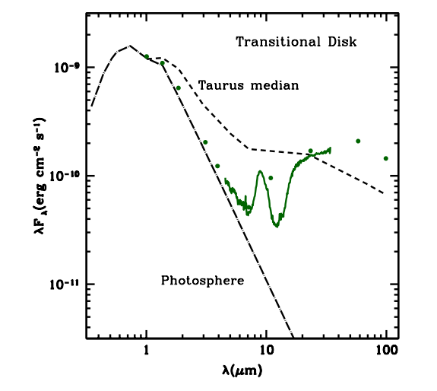
Evolution of disk geometry compared to Spectral Energy Distribution
Image Credit: Espaillat et al. (2014)

Slide 3
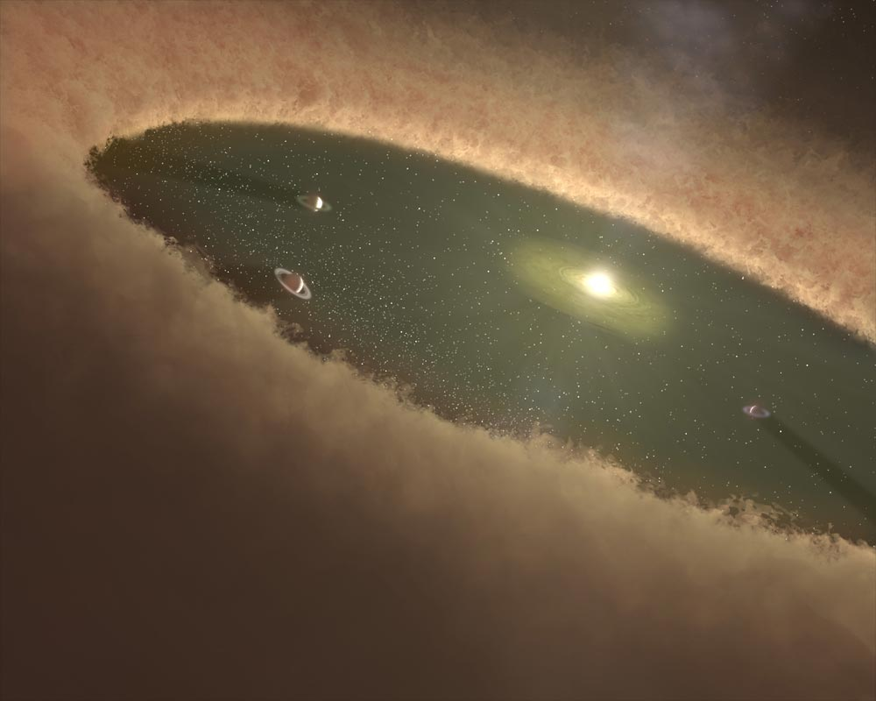
Goal:
Match simulated disk to the observed structure of LkCa 15
Main Objectives
Constrain disk parameters
Investigate planet formation
Main Tools
Spectral Energy Distribution
Polarized intensity image
Credit: NASA GSFC

Slide 4
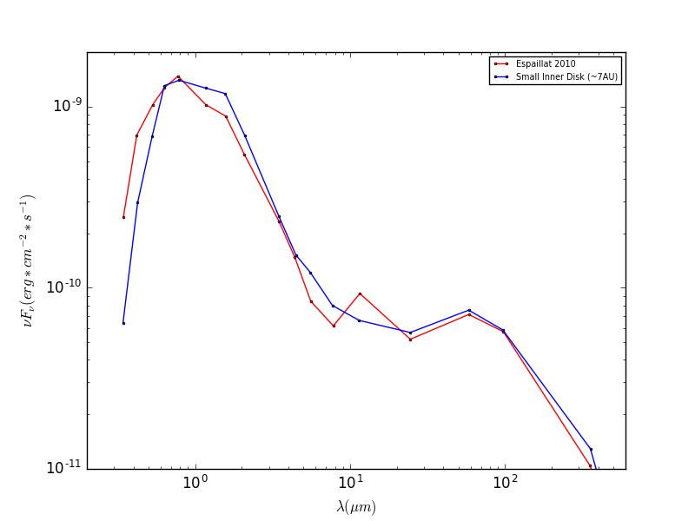
Results from SED Fitting

Slide 5
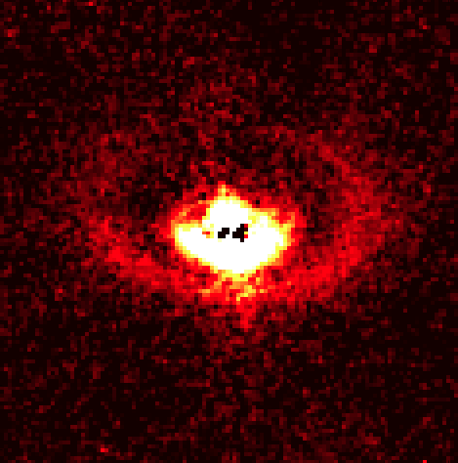
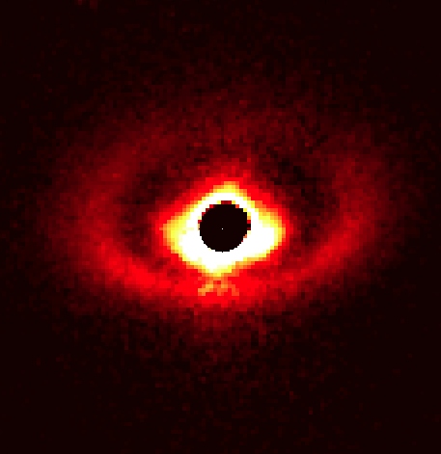
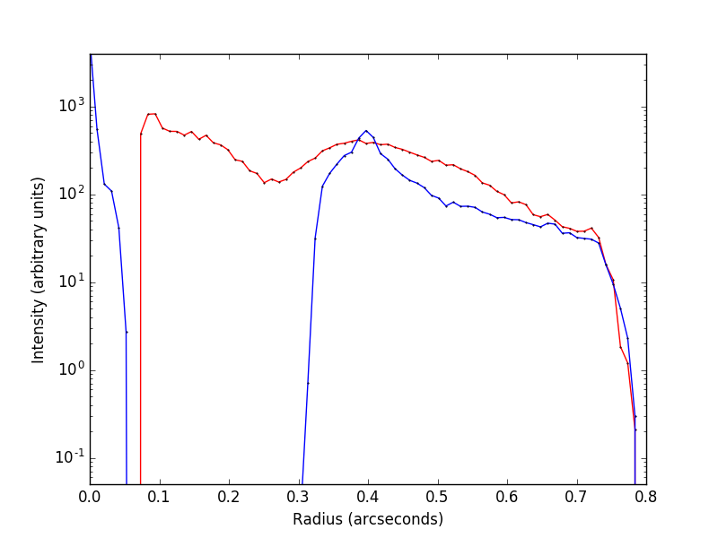
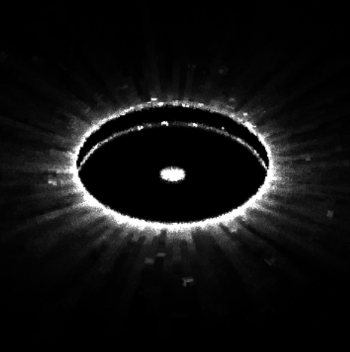
Results from SED Fitting
Top: J-band imaging polarimetry from SPHERE IRDIS as presented in Thalmann et al. 2016
.4” ≈ 56 AU

Slide 6
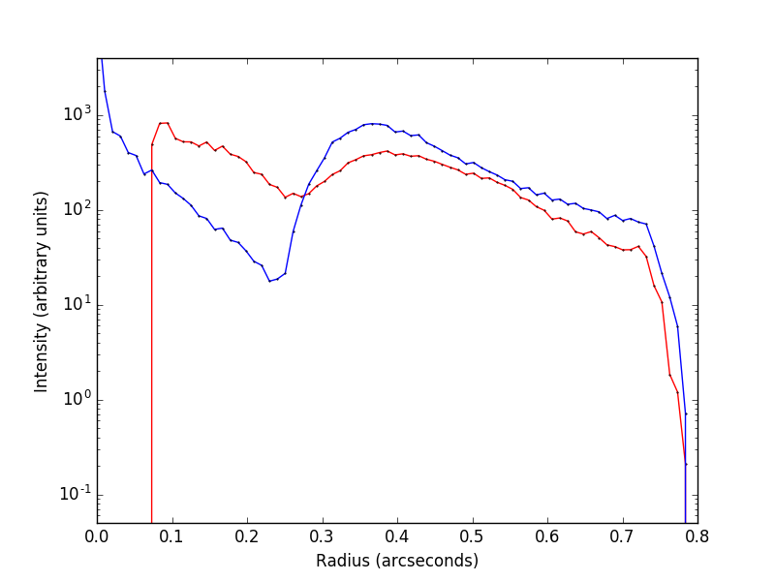
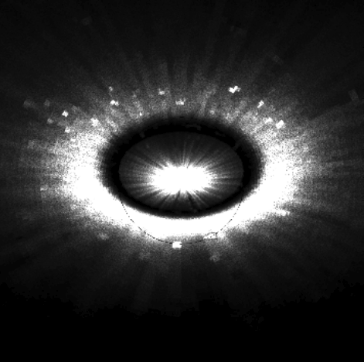
Results from Radial Profile Fitting
Top: J-band imaging polarimetry from SPHERE IRDIS as presented in Thalmann et al. 2016
.4” ≈ 56 AU

Slide 7
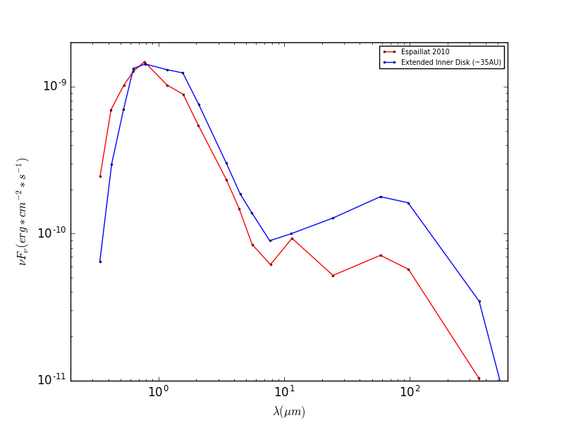
Results from Radial Profile Fitting

Slide 8
Review + Looking Forward
Inner disk is extended, consistent with Thalmann et al. 2015 observational results
Fine tune models for a model that fits SED and imaging data
Major-axis asymmetry? Minor-axis asymmetry?
Possible planet configurations? Sallum et al. 2015
.4” ≈ 56 AU

Slide 9
Acknowledgements:
Gijs Mulders
Michiel Min
Susan Brew, Chandra Holifield Collins, and all NASA Space Grant Staff

